Slide 1
Module2 – Virtualization

Slide 2























Why Virtualization?
Without Virtualization: Single OS owns all hardware resources
App
App
…...
App
Operating System
Physical Host Hardware
Processor
Memory
Graphics
Network
Storage
Keyboard
Slide <number>
http://www.edureka.co/devops

Slide 3




















Why Virtualization?
With Virtualization: Multiple OSes share hardware resources
App
App
App
App
App
App
Guest OS
Guest OS
Virtual Machine Monitor(VMM)
Physical Host Hardware
Processor Memory
Graphics
Network
Storage
Keyboard
Slide <number>
http://www.edureka.co/devops

Slide 4
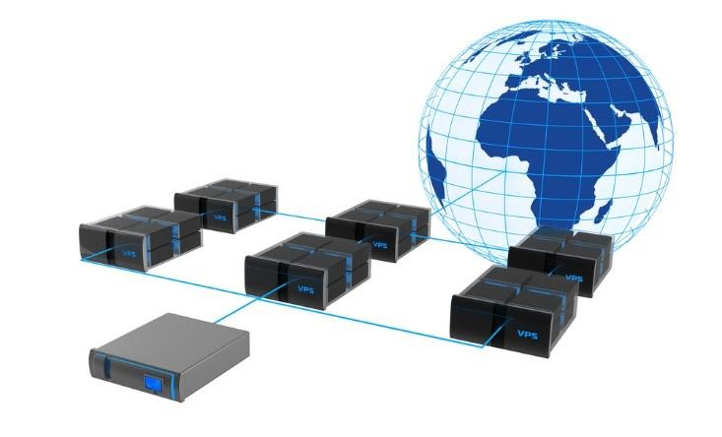
Virtualization
Virtualization means to create a virtual version of a device or resource, such as a storage device, server, network, an
OS, hardware, etc. where the framework divides the resource into one or more execution environments
→ Partitioning a hard drive is considered virtualization because one drive is partitioned to create two separate hard drives
→ Devices, applications and human users are able to interact with the virtual resource as if it were a real single logical resource
Slide <number>
http://www.edureka.co/devops

Slide 5
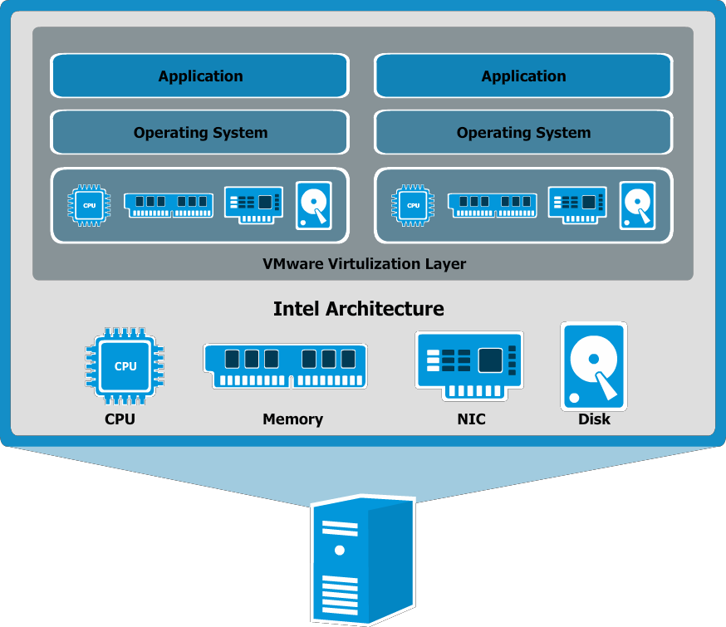
Architecture of Virtualization
VM 1
VM 2
VIRTUALISATION LAYER
Slide <number>
http://www.edureka.co/devops

Slide 6
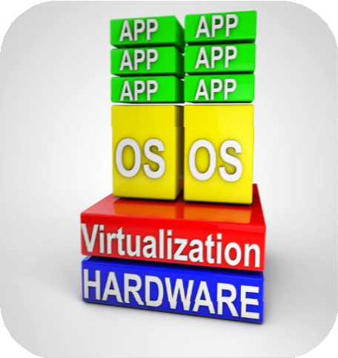
Benefits of Virtualization
Cost effectiveness
Easy of migration
Dynamic resource Allocation
Isolated environments for testing ,Dev, Prod
Easy to scale
Cutting waste and costs associated with maintaining and cooling its servers by maximizing the capabilities of one server
Slide <number>
http://www.edureka.co/devops

Slide 7



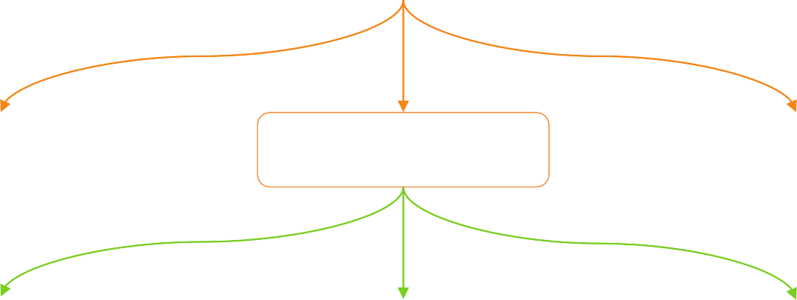











Types of Virtualization
Virtualization
Hardware Virtualization
Big Unix Vendor
Software Virtualization
Uses Hypervisor
OS Partitioning
Solaris Container
Binary Translation
Some system call intercepted & dynamic rewritten
Paravirtualization Guest OS modified to take advantage of hypervisor
Hardware Assisted Intel VT and AMD-V Relatively New(2007)
Slide <number>
http://www.edureka.co/devops

Slide 8









Virtualization
Bare-Metal:
→ Vmware ESXi
→ Oracle VM for x86(Xen)
→ Xen(used by Amazon)
→ Hyper-V(Windows 2008 Server)
→ KVM
Hardware
Hypervisor
VM 1 VM 2 VM 3
Hosted:
→ Vmware Server, Workstation
→ Oracle VirtualBox
→ Microsoft Virtual PC
→ Others: Qemu, coLinux
→ KVM
Hardware Operating System
Hypervisor
VM 1 VM 2 VM 3
Slide <number>
http://www.edureka.co/devops

Slide 9
Hypervisors
→ A hypervisor, also known as virtual machine manager, is a program used for hardware virtualization techniques
→ It allows multiple operating systems (guests), to run concurrently on a host computer allowing multiple
operating systems to share a single hardware
→ Each operating system appears to have the host's processor, memory, and other resources all to itself
→ However, the hypervisor is actually allocating what is needed to each operating system in turn and making sure that the virtual machines don't disrupt each other
Slide <number>
http://www.edureka.co/devops

Slide 10











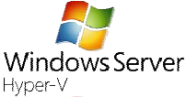
Types of Hypervisors
Xen hypervisor uses a microkernel design to provide services that allows multiple OS to execute on the same computer concurrently
KVM (Kernel-based Virtual Machine) is a virtualization infrastructure for the Linux kernel that turns it into a hypervisor
VMware ESXi is an enterprise-class, type-1 hypervisor for deploying and serving virtual computers
Hyper-V, codenamed Viridian is a native hypervisor; it can create virtual machines on x86-64 systems
Slide <number>
http://www.edureka.co/devops

Slide 11
VirtualBox
Slide <number>
http://www.edureka.co/devops

Slide 12
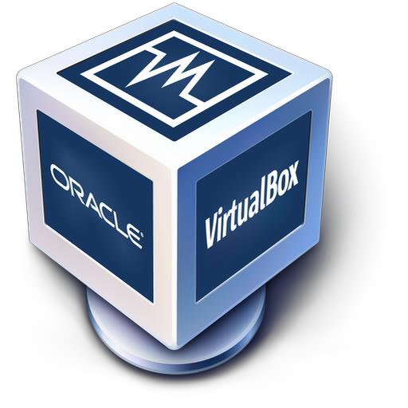
Oracle VirtualBox
Oracle VM VirtualBox is a virtualization software package for x86 and AMD64/Intel64-based computers from Oracle Corporation
→ It is an extremely feature rich, high performance product for enterprise customers
→ it is also the only professional solution that is freely available as Open Source Software under the terms of the GNU General Public License
→ VirtualBox runs on Windows, Linux, Macintosh, and Solaris hosts and supports a large number of guest OS
Slide <number>
http://www.edureka.co/devops

Slide 13
Installation of VM using VirtualBox
→ VirtualBox from Oracle is available for free from the developer's website
→ Make sure that you download the correct version for your operating system
→ Click on your downloaded file to execute it to start the installation
→ After installation a command named “virtual box” will be created
Slide <number>
http://www.edureka.co/devops

Slide 14
Thanks

